Slide 1
Team 1
Team Members:
Sowmya Boyalagunta
Sri Venkatesh
Savita Mansharamani
Suvojit Dey
Veerabadrarao Chittuluri
Segu Mahesh

Slide 2
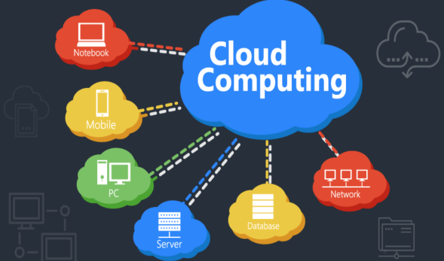
Cloud Computing
Cloud computing is the on-demand availability of computer system resources, especially data storage and computing power, without direct active management by the user.
Why Cloud Computing:
Un limited storage capacity
Data security
Backup and restore
Scalability
Cost reduction

Slide 3
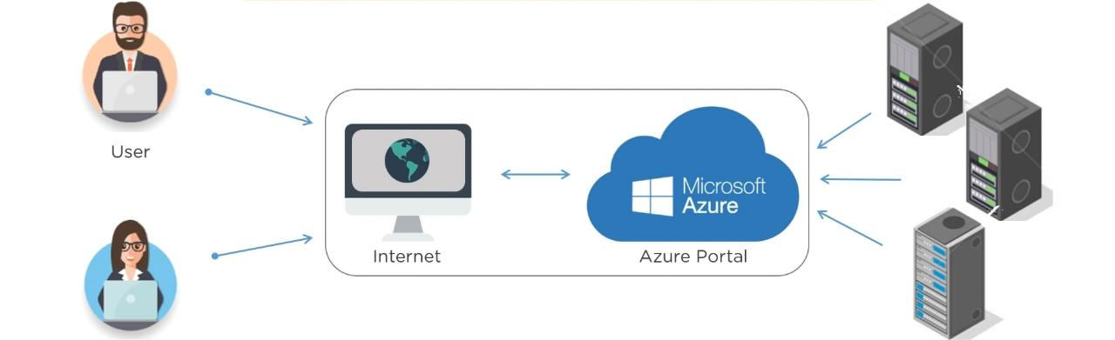
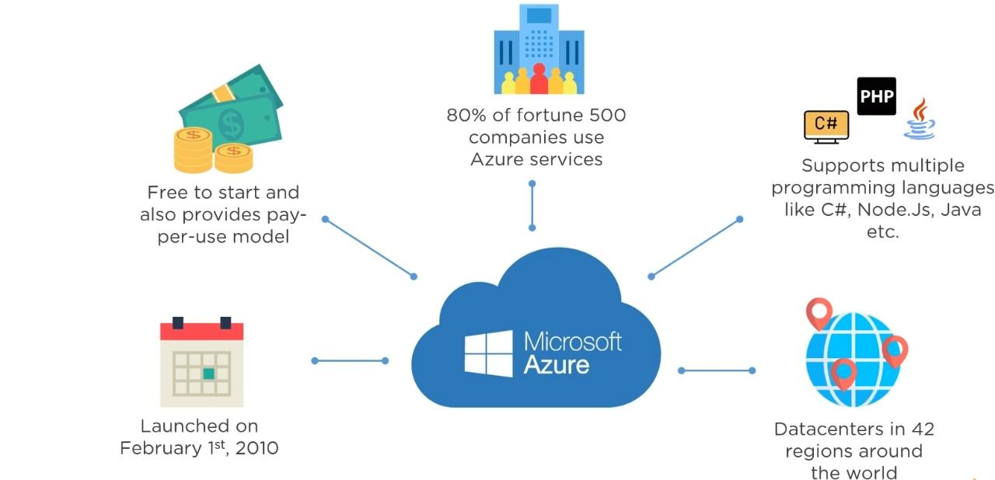
Azure
Microsoft Azure, formerly known as Windows Azure, is Microsoft's public cloud platform. It provides a range of cloud services, including compute, analytics, storage and networking. Users can pick and choose from these services to develop and scale new applications, or run existing applications

Slide 4
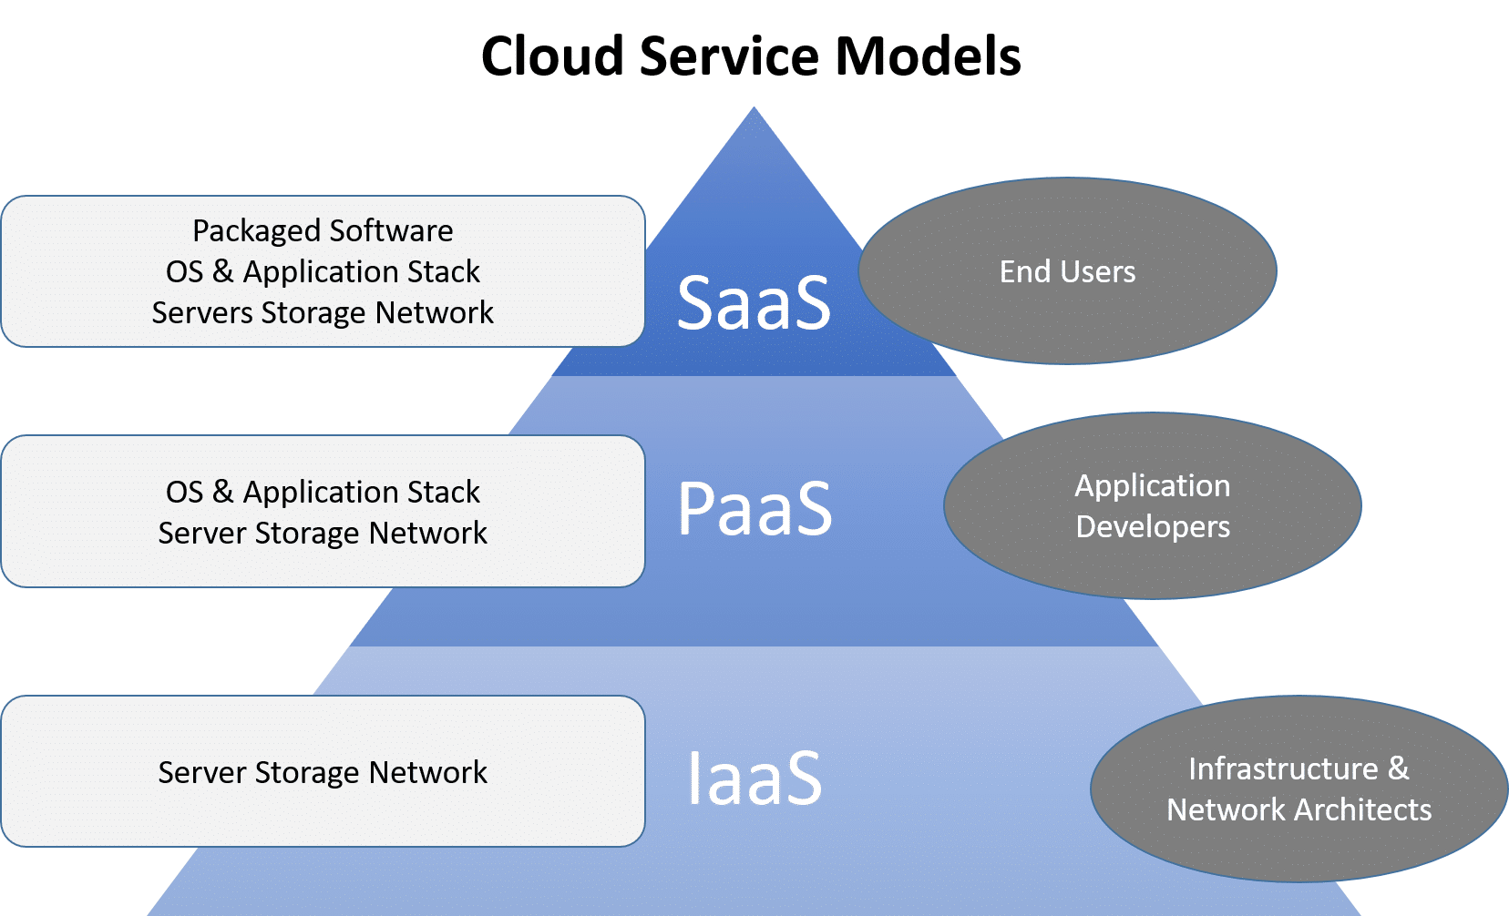
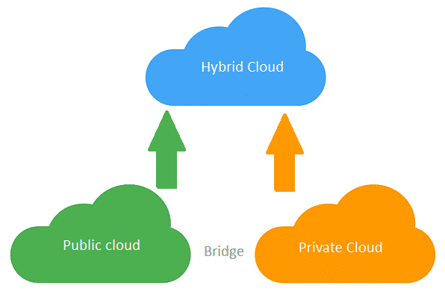
Cloud Service Models:
Infrastructure as a Service
Platform as a Service
Software as a Service
Types of cloud computing:
Public Cloud
Private Cloud
Hybrid Cloud

Slide 5
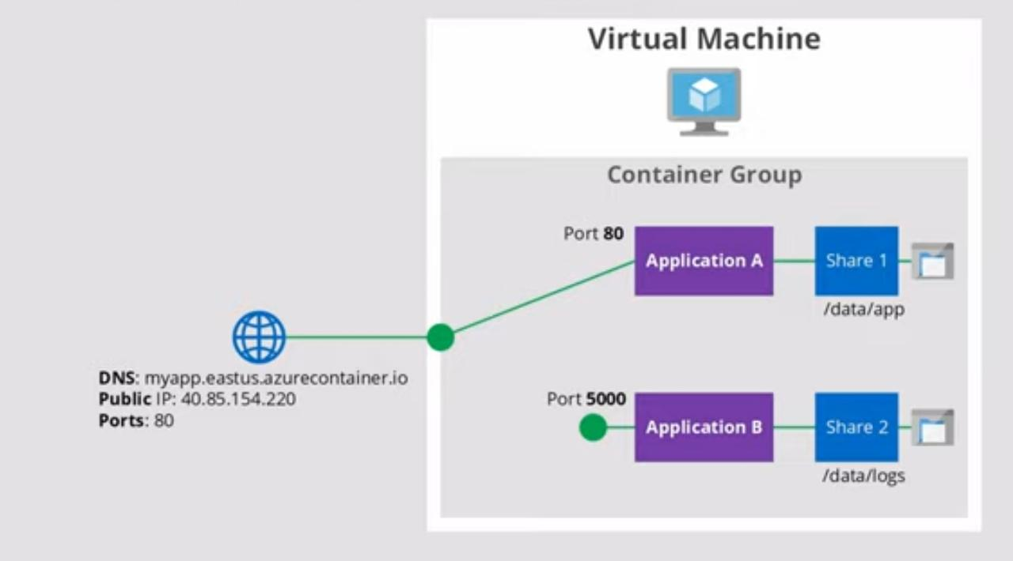
Azure VM:
Azure Virtual Machines (VM) is one of several types of on demand scalable computing resourse that Azure offers. Typically, you choose a VM when you need more control over the computing environment than the other choices offer.
Azure Container Instance:
Fast startup
Public IP , DNS
Customized Size
Both linux ,windows containers

Slide 6
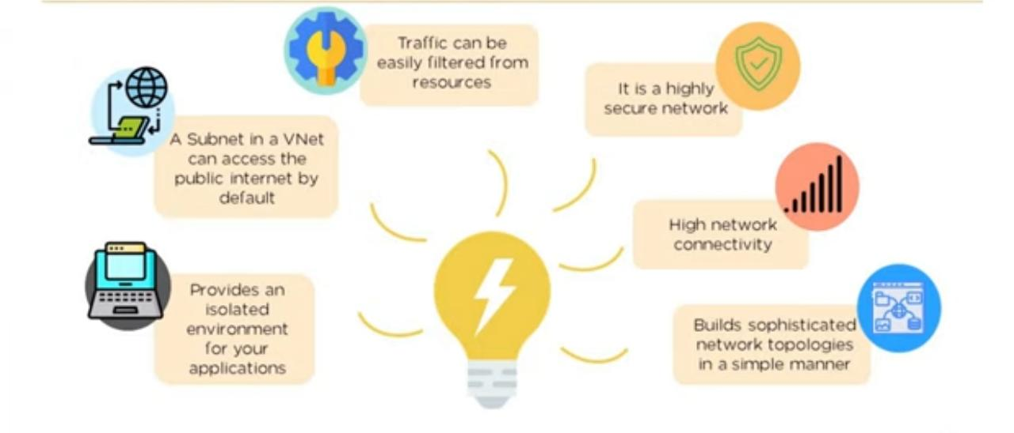
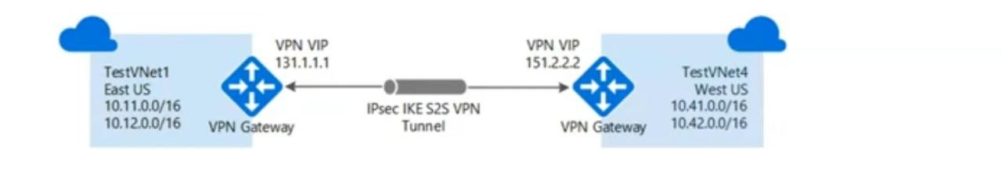
Virtual Network:
An Azure Virtual Network is a network or environment that can be used to run VMs and application in the cloud.
VPN Gateway:

Slide 7
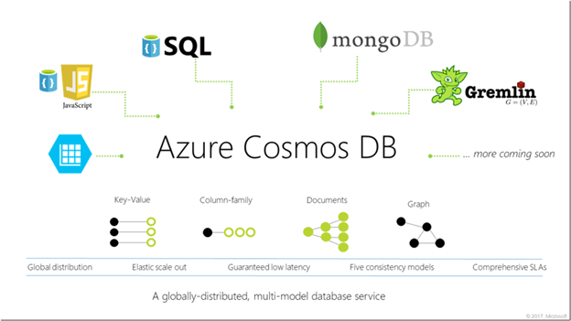
Azure Database & Analytic services
Cosmos DB:
Azure Cosmos DB is a fully managed NoSQL database for modern app development. Single-digit millisecond response times, and automatic and instant scalability, guarantee speed at any scale.
Azure Cosmos DB is suitable for any high-
performance application that requires global
scale.

Slide 8
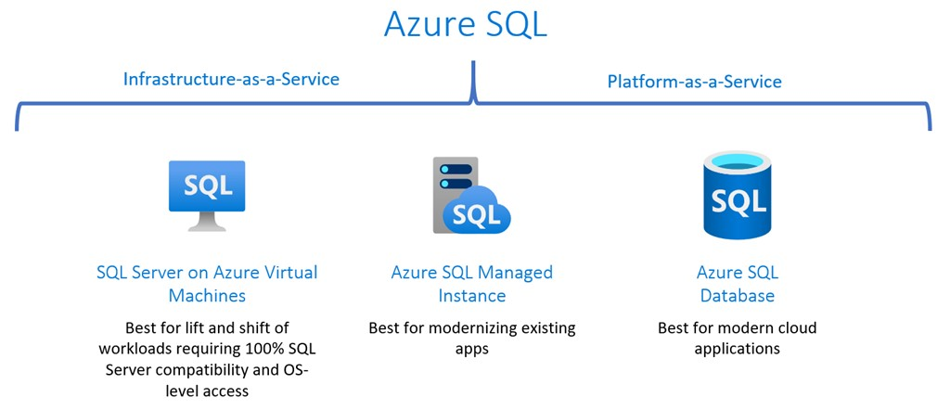
SQL Database:
Azure Compute Service
App Service
Azure functions

Slide 9
Azure IOT
The Azure Internet of Things (IoT) is a collection of Microsoft-managed cloud services that connect, monitor, and control billions of IoT assets.
Azure IOT Services:
IOT HUB:
Managed Service for Bi directional communication between your IoT application and the devices it manages.
Platform as a service
It can be integrated with lots of Azure services.
Highly secure, scalable and reliable.

Slide 10
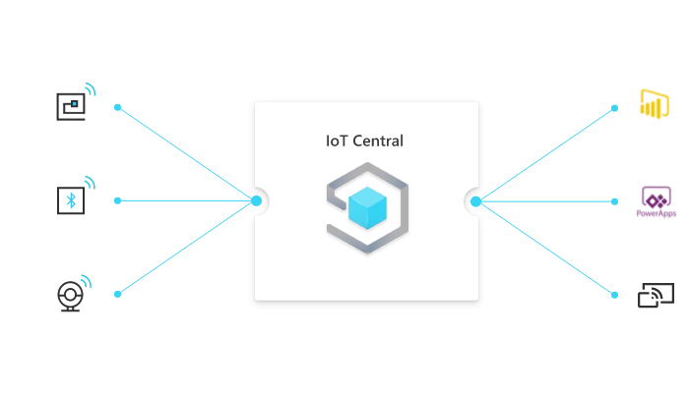
Contd...
IOT Central:
It is builds on top of IoT Hub by adding a dashboard that allows you to connect, monitor, and manage your IoT devices.
Software as a service.
Industry specific templates
No deep knowledge required.
IOT Sphere:
It creates an end-to-end, highly secure IoT solution for customers that encompasses everything from the hardware and operating system on the device to the secure method of sending messages from the device to the message hub.

Slide 11
Azure AI
Azure Machine learning is a platform for making predictions. It consists of tools and services that allow you to connect to data to train and test models to find one that will most accurately predict a future result.
Azure Cognitive Services:
It provides prebuilt machine learning models that enable applications to see, hear, speak, understand, and even begin to reason.
While Azure Machine Learning requires you to bring your own data and train models over that data, Azure Cognitive Services, for the most part, provides pretrained models so that you can bring in your live data to get predictions on.
Azure Bot Services:
Bot Framework are platforms for creating virtual agents that understand and reply to questions just like a human.
The bot you build uses other Azure services, such as Azure Cognitive Services, to understand what their human counterparts are asking for.

Slide 12
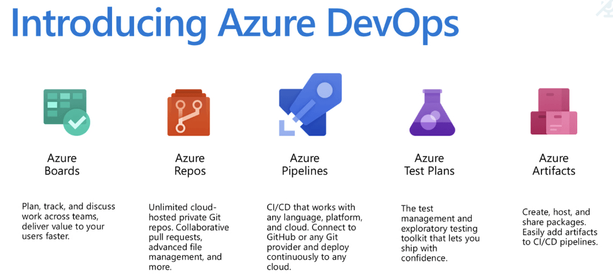
Azure DevOps
Azure DevOps :
1. Provides developer services for allowing teams to plan work, collaborate on code development, and build and deploy applications.
2. It allows organizations to create and improve products at a faster pace than they can with traditional software development approaches.
Azure DevTest Labs:
1. Cloud based environment for developers & testers with self service environment, reusable template,
Cost management, and multiple intergrations.

Slide 13
Components of Azure DevOps:
1. Azure Boards:
Azure Boards is as service , for managing the work of your software projects.
Features:
Work items
Boards
Backlogs
Sprints
Dashboards
2. Azure Repos provides Git repositories or Team Foundation Version Control (TFVC) for source control of your code.
3. Azure Pipelines provides build and release services to support continuous integration and delivery of your applications.

Slide 14
Azure Artifacts allows teams to share packages such as Maven, npm, NuGet, and more from public and private sources and integrate package sharing into your pipelines.
Azure Test Plans provides several tools to test your apps, including manual/exploratory testing and continuous testing.

Slide 15
Tools to manage and configure Azure environment
Microsoft offers a variety of tools and services to manage your cloud environment, each aimed at different scenarios and users.
1. Azure portal:
It is a web-based user interface, you can access virtually every feature of Azure. The Azure portal provides a friendly, graphical UI to view all the services you're using, create new services, configure your services, and view reports.
2. Azure Powershell:
It is a set of cmdlets for managing Azure resources directly from the PowerShell command line.
Multiplatform and Powershell core
1. Connect-AzAccount – log into Azure
2. Get-AzResourceGroup – list resource groups
3.New-AzResourceGroup – create new resource group
4.New-AzVm – create virtual machine

Slide 16
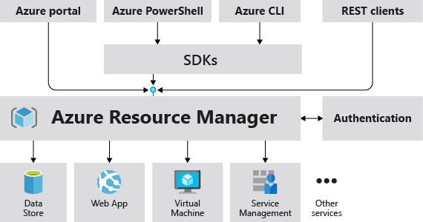
2. Azure CLI:
The Azure command-line interface (Azure CLI) is a set of commands used to create and manage Azure resources.
Multi-platform
1. az login – log into Azure
2. az group list – list resource groups
3. az group create – create new resource group
4. az vm create – create virtual machine
3. Azure ARM:
Azure Resource Manager is the deployment and management service for Azure. It provides a management layer that enables you to create, update, and delete resources in your Azure account.
Uses ARM Templates (Json Format)

Slide 17
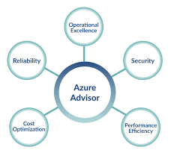
Monitoring Services
1. Azure Advisor:
It is a Microsoft Azure service that provides recommendations based on your deployed Azure services configuration.
2. Azure Monitor:
Azure Monitor helps you maximize the availability and performance of your applications and services.
It delivers a comprehensive solution for collecting, analyzing, and acting on telemetry from your cloud and on-premises environments.
3. Azure Service Health:
Azure Service Health notifies you about Azure service incidents and planned maintenance so you can take action to mitigate downtime.

Slide 18
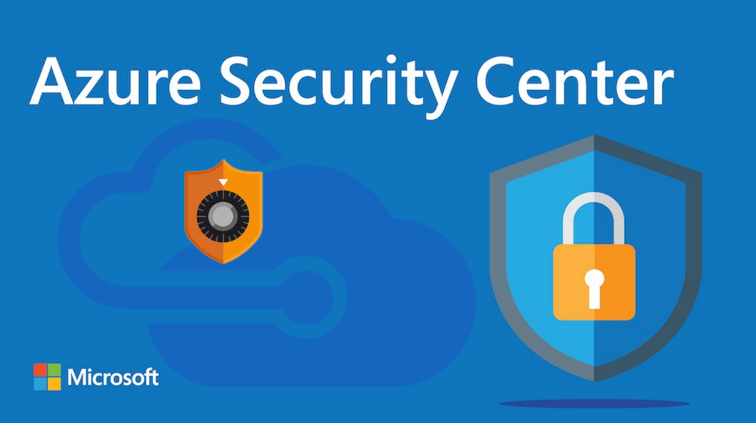
General & Network Security
Azure Security Center
Microsoft Azure Security Center is a set of tools for monitoring and managing the security of virtual machines and other cloud computing resources within the Microsoft Azure public cloud. Administrators access the Azure Security Center through the Azure management portal.

Slide 19
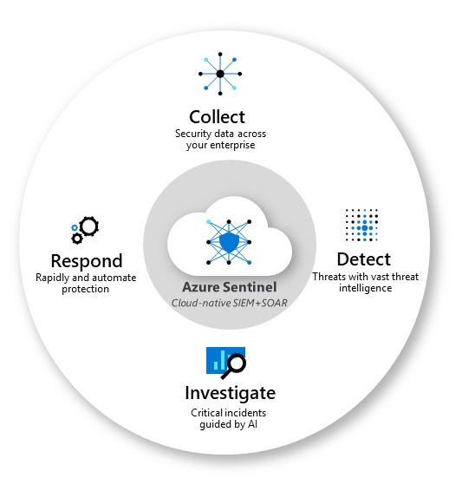
Azure Sentinel
Microsoft Sentinel aggregates data from all sources, including users, applications, servers, and devices running on-premises or in any cloud, letting you reason over millions of records in a few seconds. It includes built-in connectors for easy onboarding of popular security solutions

Slide 20
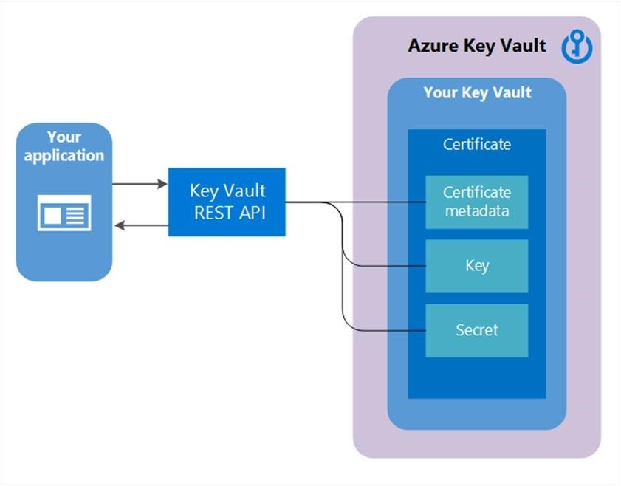
Azure key vault
Azure Key Vault is a cloud service for securely storing and accessing secrets. A secret is anything that you want to tightly control access to, such as API keys, passwords, certificates, or cryptographic keys. Key Vault service supports two types of containers: vaults and managed hardware security module(HSM) pools. Vaults support storing software and HSM-backed keys, secrets, and certificates. Managed HSM pools only support HSM-backed keys.

Slide 21
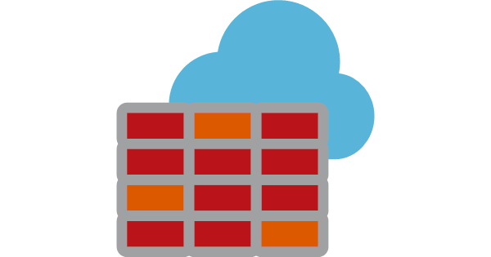
Azure Firewall
Azure Firewall is a cloud-native and intelligent network firewall security service that provides the best of breed threat protection for your cloud workloads running in Azure. It's a fully stateful, firewall as a service with built-in high availability and unrestricted cloud scalability

Slide 22

Azure DDos Protection
DDoS Protection enables you to protect your Azure resources from denial of service (DoS) attacks with always-on monitoring and automatic network attack mitigation. There is no upfront commitment and your total cost scales with your cloud deployment.

Slide 23
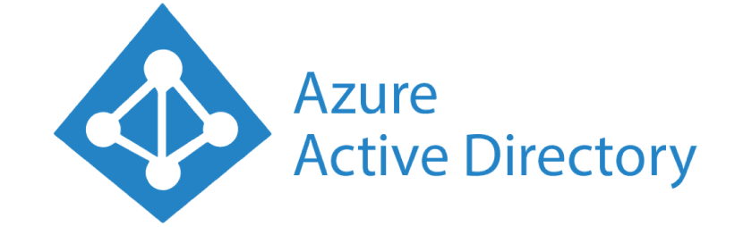
Azure Active Directory
Azure Active Directory (Azure AD) is Microsoft’s cloud-based identity and access management service, which helps your employees sign in and access resources in:
External resources, such as Microsoft 365, the Azure portal, and thousands of other SaaS applications.
Internal resources, such as apps on your corporate network and intranet, along with any cloud apps developed by your own organization. For more information about creating a tenant for your organization.

Slide 24
Conditional access
RBAC- Azure role-based access control (Azure RBAC) is a system that provides fine-grained access management of Azure resources. Using Azure RBAC, you can segregate duties within your team and grant only the amount of access to users that they need to perform their jobs.
Azure broadly defines three different roles: Reader, Contributor, and Owner. These roles apply to Subscriptions, Resource Groups, and most all Resources on Azure
The modern security perimeter now extends beyond an organization's network to include user and device identity. Organizations can use identity-driven signals as part of their access control decisions.
Conditional Access brings signals together, to make decisions, and enforce organizational policies. Azure AD Conditional Access is at the heart of the new identity-driven control plane.

Slide 25
Resource lock -As an administrator, you can lock a subscription, resource group, or resource to prevent other users in your organization from accidentally deleting or modifying critical resources. The lock overrides any permissions the user might have.
You can set the lock level to Can not Delete or ReadOnly. In the portal, the locks are called Delete and Read-only respectively.
Can Not Delete means authorized users can still read and modify a resource, but they can't delete the resource.
Read Only means authorized users can read a resource, but they can't delete or update the resource. Applying this lock is similar to restricting all authorized users to the permissions granted by the Reader role
Azure Policy - Azure Policy is a service in Azure which allows you create polices which enforce and control the properties of a resource. When these policies are used they enforce different rules and effects over your resources, so those resources stay compliant with your IT governance standards
Azure Blueprints- A blueprint is a package or container for composing focus-specific sets of standards, patterns, and requirements related to the implementation of Azure cloud services, security, and design that can be reused to maintain consistency and compliance

Slide 26
Microsoft Privacy Statement –Microsoft privacy statement explains the personal data Microsoft processes, how Microsoft processes it, and for what purposes.
Microsoft offers a wide range of products, including server products used to help operate enterprises worldwide, devices you use in your home, software that students use at school, and services developers use to create and host what’s next. References to Microsoft products in this statement include Microsoft services, websites, apps, software, servers, and devices.
Trust center - The Trust Center is where you can find security and privacy settings for Microsoft Office programs. With the consistent appearance of the ribbon in Office programs, steps to find the Trust Center are the same for each program.
Azure government - Azure Government is the mission-critical cloud, delivering breakthrough innovation to US government customers and their partners. Only US federal, state, local and tribal governments and their partners have access to this dedicated instance, operated by screened US citizens.

Slide 27
Azure cost , SLA and Lifecycle
Cost- Microsoft Azure prices start at $13 a month. But, like all of the services tested, it gets complicated after that. My benchmark, for example, would have run me about $65 per month. That's as pricy as any of these services in this roundup.
SLA - The SLA starts at a lowly 95% on Single Instance Virtual Machines using Standard HDD Disks to 99,99% for multi instance Virtual Machines deployed across two or more Availability Zones in the same Azure region.
Lifecycle- A lifecycle policy enables you to move your backups between storage tiers after a specified number of days. For example, you back up data to a Hot tier, then your backup data is moved automatically to a Cool storage after 30 days, and then this data is moved to Archive tier automatically after 60 days.

Slide 28
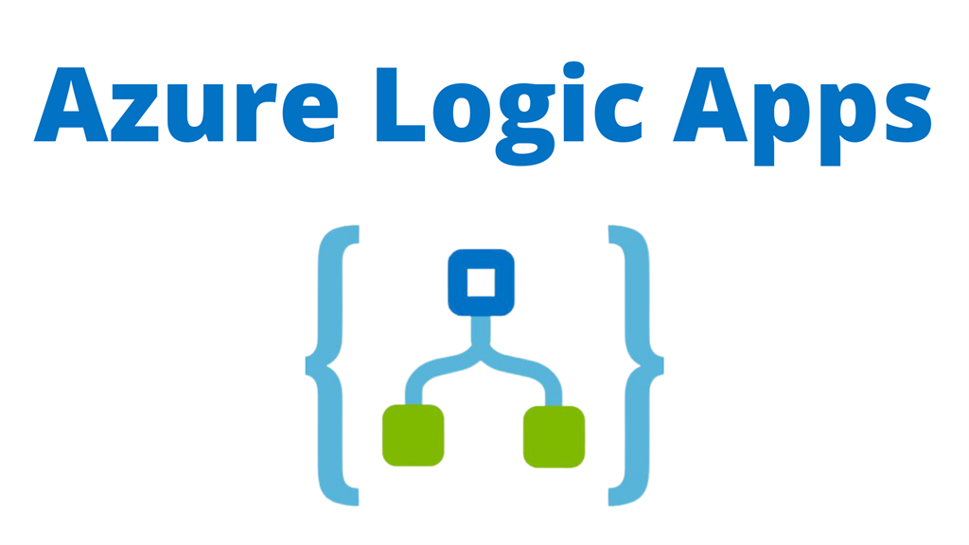
Azure Logic Apps
What is the Microsoft Azure Logic Apps Platform?
Microsoft Azure Logic Apps is a cloud-based service allowing developers to carry out all development tasks through precise actions like scheduling, automation, task orchestration, business process management, and workflow management.
How Can You Develop Enterprise Integration Solution to Take Advantage of Azure Logic Apps?
Why Should We Use Azure Logic Apps?
The principal motto of Azure Logic Apps service is to connect the traditional and legacy systems with modern systems in an easy and seamless manner.

Slide 29
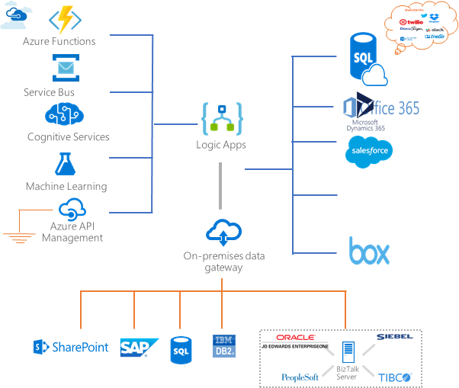
How Does Azure Logic Apps Work?

Slide 30
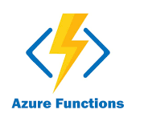
Microsoft Azure Functions
What Is Azure Function?
Azure Functions is the serverless computing service hosted on the Microsoft Azure public cloud. Azure Functions, and serverless computing, in general, is designed to accelerate and simplify application development.
Why use Azure Function?
Azure functions are lightweight and serverless.
Azure functions are easier to write and deploy.
Azure Functions pricing, limits and requirements

Slide 31
Differences between Azure Functions and Azure Logic Apps
 | Functions | Logic Apps
State | Normally stateless, but Durable Functions provide state | Stateful
Development | Code-first (imperative) | Designer-first (declarative)
Connectivity | About a dozen built-in binding types, write code for custom bindings | Large collection of connectors, Enterprise Integration Pack for B2B scenarios, build custom connectors
Actions | Each activity is an Azure function; write code for activity functions | Large collection of ready-made actions
Monitoring | Azure Application Insights, Log Analytics via Application Insights connector | Azure portal, Log Analytics
Management | REST API, Visual Studio | Azure portal, REST API, PowerShell, Visual Studio
Execution context | Can run locally or in the cloud | Runs only in the cloud.

Slide 32
Azure Messaging Services:
Event:
An event is a lightweight notification of a condition or a state change. The publisher of the event has no expectation about how the event is handled. The consumer of the event decides what to do with the notification.
Message:
A message is raw data produced by a service to be consumed or stored elsewhere. The message contains the data that triggered the message pipeline. The publisher of the message has an expectation about how the consumer handles the message.

Slide 33
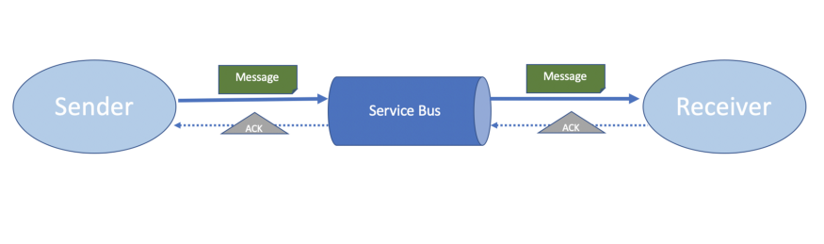
Azure Service Bus
Service Bus is a fully managed enterprise message broker with message queues and publish-subscribe topics. The service is intended for enterprise applications that require transactions, ordering, duplicate detection, and instantaneous consistency.
Azure Service Bus supports various advanced queuing operations and some of the key differentiating capabilities are:
Message sessions
Auto forwarding
Scheduled delivery
Message deferral
Transactions
Filtering and actions
Autodelete on idle
Duplicate detection

Slide 34
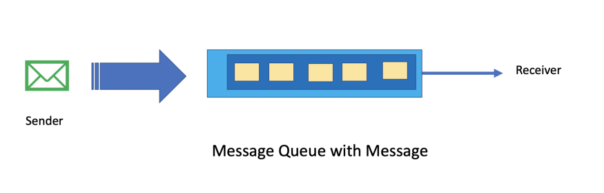
Azure Service Bus Queue
Azure Service Bus Queue is an ordered, time-stamped message storage. it can be used for point-to-point communication which means a single producer of the message works with a single receiver that reads from the queue. The messages are delivered in a pull mode and a consumer is responsible to deQueue the message after it is processed to free up the storage.

Slide 35
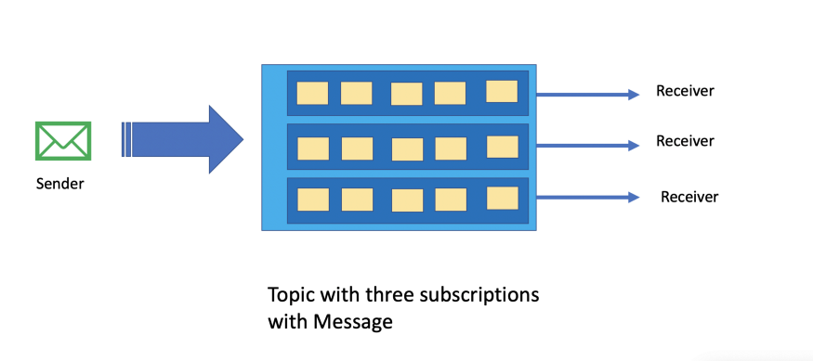
Azure Service Bus Topic
Azure Service Bus Topic is also a queue internally but it is designed for point to multi-point communication. This means we have a message publisher writing messages to the topic and each topic subscription receives a copy of the message. Messages are received from a subscription identically to the way they are received from a queue.

Slide 36
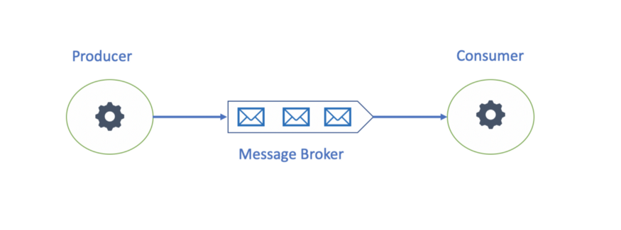
Azure Storage Queues
Azure Storage Queues is part of the Azure storage account. It is a simple, reliable, scalable, and persistent message queuing service. A queue can store millions of messages up to the total capacity of a storage account where each message can be up to 64 KB and a maximum TTL of 7 days.

Slide 37
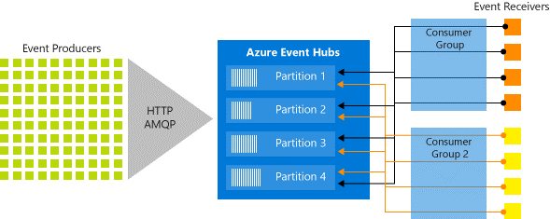
Azure Event Hub
Azure Event Hub is a fully managed PaaS Big data event streaming platform & event ingestion service capable of receiving and processing millions of messages per second with low latency. It is designed to handle the volume, variety & velocity of events. It also supports Advanced Message queuing protocol(AMQP). Each consuming application gets its own event stream.

Slide 38
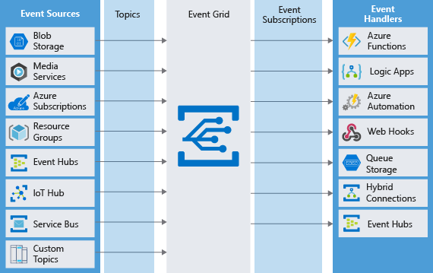
Azure Event Grid
Event Grid is an eventing backplane that enables event-driven, reactive programming. It uses the publish-subscribe model. Publishers emit events, but have no expectation about how the events are handled. Subscribers decide on which events they want to handle.

Slide 39
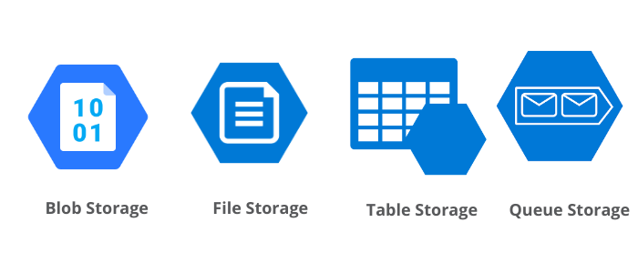
Azure Storage
Azure Storage is Microsoft's cloud storage solution for modern data storage scenarios. Azure Storage offers a massively scalable object store for data objects, a file system service for the cloud, a messaging store for reliable messaging, and a NoSQL store.
Azure Storage is
Durable
Secure
Scalable
Managed
Accessible

Slide 40
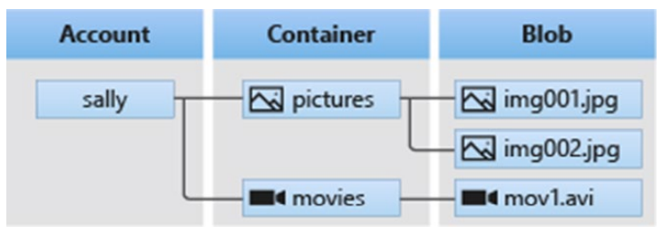
Blob Storage
A Massive Scalable object store for text and binary data
Ideal for
Serving images or documents directly to a browser.
Storing files for distributed access.
Streaming video and audio.
Writing to log files.
Storing data for backup and restore, disaster recovery, and archiving.
Storing data for analysis by an on-premises or Azure-hosted service.

Slide 41
Blob Access Tier
Azure storage provides different options for accessing block blob data based on usage patterns.
Hot: optimized for storing data that is accessed or modified frequently.
Cool:optimized for storing data that is infrequently accessed or modified. Data in the Cool tier should be stored for a minimum of 30 days. The Cool tier has lower storage costs and higher access costs compared to the Hot tier.
Archive:optimized for storing data that is rarely accessed, and that has flexible latency requirements, on the order of hours. Data in the Archive tier should be stored for a minimum of 180 days.

Slide 42
File Storage
File storage offers cloud-based file shares, so that you can migrate legacy applications to Azure quickly and without costly rewrites.
Applications running in Azure virtual machines or cloud services can mount a File storage share to access file data, just as a desktop application would mount a typical SMB share. Any number of application components can mount and access the File storage share simultaneously.
Since a File storage share is a standard SMB 2.1 file share, applications running in Azure can access data in the share via file sytem I/O APIs. Developers can therefore leverage their existing code and skills to migrate existing applications. IT Pros can use PowerShell cmdlets to create, mount, and manage File storage shares as part of the administration of Azure applications

Slide 43
Table Storage
Table storage offers highly available, massively scalable storage, so that your application can automatically scale to meet user demand.
Table storage is Microsoft's NoSQL key/attribute store it has a schemaless design, making it different from traditional relational databases. With a schemaless data store, it's easy to adapt your data as the needs of your application evolve.
Table storage is easy to use, so developers can create applications quickly. Access to data is fast and cost-effective for all kinds of applications.
Table storage is typically significantly lower in cost than traditional SQL for similar volumes of data.

Slide 44
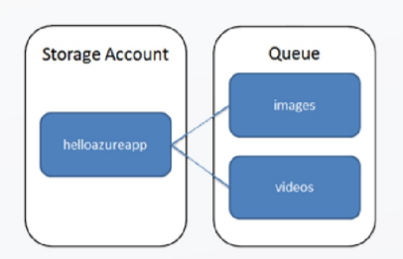
Queue Storage
Queue storage provides a reliable messaging solution for asynchronous communication between application components, whether they are running in the cloud, on the desktop, on an on-premises server, or on a mobile device.
Queue storage also supports managing asynchronous tasks and building process workflows.
A storage account can contain any number of queues.
A queue can contain any number of messages, up to the capacity limit of the storage account. Individual messages may be up to 64 KB in size

Slide 45
Data Redundancy
Azure Storage replicates multiple copies of your data
Replication options for storage account include:
Locally redundant storage (LRS)
Zone-redundant storage (ZRS)
Geo-redundant storage (GRS)
Read-access geo-redundant storage (RA-GRS)

Slide 46
AZURE API MANAGEMENT
Azure API Management is a hybrid, multicloud management platform for APIs across all environments.
Azure API Management helps customers meet these challenges:
Abstract backend architecture diversity and complexity from API consumers
Securely expose services hosted on and outside of Azure as APIs
Protect, accelerate, and observe API
Enable API discovery and consumption by internal and external users
SCENARIOS:
Unlocking legacy assests
API-centric app integration
Multi channel use experience
B2B integration

Slide 47
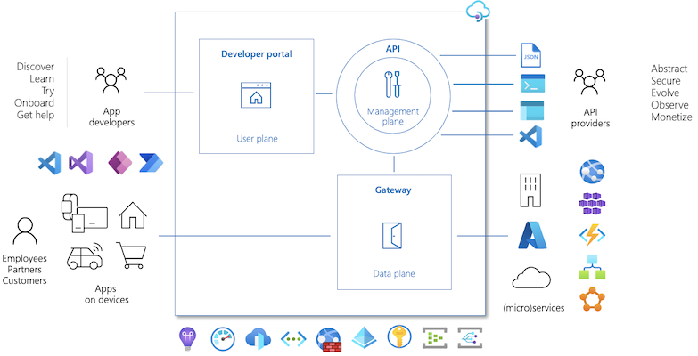
COMPONENTS
Azure API Management is made up of an API gateway, a management plane, and a developer portal. These components are Azure-hosted and fully managed by default. API Management is available in various tiers differing in capacity and features.

Slide 48
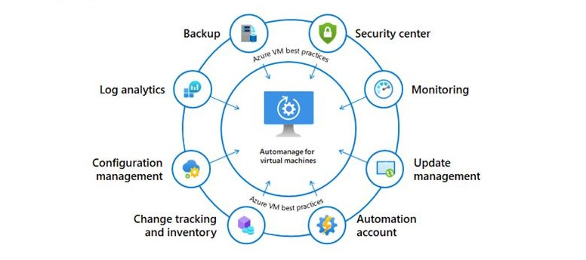
AZURE VMS
Azure Virtual Machines (VM) is one of several types of on-demand, scalable computing resources that Azure offers. Typically, you choose a VM when you need more control over the computing environment than the other choices offer.
Azure virtual machines can be used in various ways.
Development and test
Applications in cloud
Extended datacenter

Slide 49
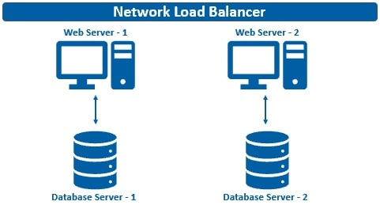
AVAILABILITY SET
An availability set is a logical grouping of VMs that allows Azure to understand how your application is built to provide for redundancy and availability. We recommended that two or more VMs are created within an availability set to provide for a highly available application and to meet the 99.95% Azure SLA. There is no cost for the Availability Set itself, you only pay for each VM instance that you create.

Slide 50
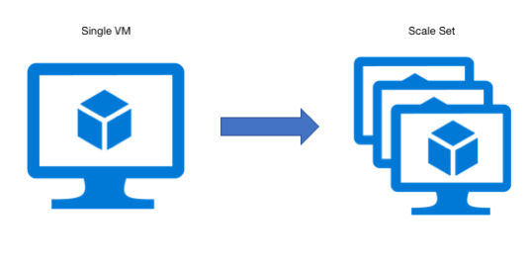
SCALE SET Scale sets provide an ability to deploy and manage multiple identical VMs. Scaling in and out allows Azure administrators to increase or decrease the number of VMs in a set based on various parameters used to monitor the performance of the application

Slide 51
MONITORING
Azure Monitor helps you maximize the availability and performance of your applications and services. It delivers a comprehensive solution for collecting, analyzing, and acting on telemetry from your cloud and on-premises environments.
APPLICATION INSIGHTS:
Application Insights is a feature of Azure Monitor that provides extensible application performance management (APM) and monitoring for live web apps. Developers and DevOps professionals can use Application Insights to:
Automatically detect performance anomalies.
Help diagnose issues by using powerful analytics tools.
See what users actually do with apps.
Help continuously improve app performance and usability.

Slide 52
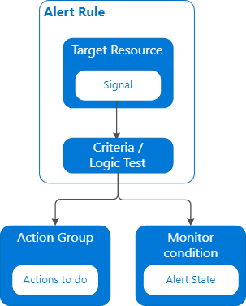
LOG ANALYTICS
Log Analytics is a tool in the Azure portal to edit and run log queries from data collected by Azure Monitor Logs and interactively analyze their results. You can use Log Analytics queries to retrieve records that match particular criteria, identify trends, analyze patterns, and provide a variety of insights into your data.
AZURE ALERTS:

